Slide 1
Breakout Reference Slides
Scroll through these slides, which are the same ones from live session that are on the topic of power and error.
(Hit the arrows below the slides to advance the slides.)

Slide 2


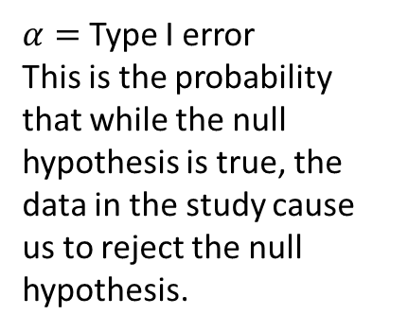
Let’s Talk Power!!!
$β=$ Type II error
This is the probability that while the null hypothesis is NOT true, the data in the study cause us to fail to reject the null hypothesis (fail to detect differences in the means).
$α=$ Type I error
This is the probability that while the null hypothesis is true, the data in the study cause us to reject the null hypothesis.
Power = $1−β$
This is the probability that while the null hypothesis is NOT true, the data in the study correctly cause us to reject the null hypothesis (detect differences in the means).
Effect size basically measures the difference between the population mean (106) and the null mean(100). (It’s not exactly this, though.)

Slide 3
Explore power!
Here is an applet that will show you what happens to the power/beta when you change the sample size, alpha, standard deviation, or effect size (measure of the difference between null mean and actual (alternative) mean).
http://shiny.stat.tamu.edu:3838/eykolo/power/

